Slide 1
Machine Learning
in Agricultural, Environmental and Applied Economics
Hugo Storm, Kathy Baylis, Thomas Heckelei

Slide 2
Outline Part I ML from an applied econometrics perspective
Approach to avoid overfitting
Supervised approaches
Shrinkage methods
Tree based methods
Neural networks
Unsupervised approaches
Model complexity versus interpretability

Slide 3
Outline Part II What ML can add to our toolbox
Restrictive functional forms
Extract information from unstructured data
Large number of explanatory variables
Causal inference and Identification
Limitations of simulation models for policy analysis

Slide 4

For today
Shameless self promotion ( )
Quick overview of Neural Networks (NN)
How can they help?
Restrictive functional forms
Extract information from unstructured data
Deal with a large number of explanatory variables
Causal inference and Identification
Example: NN for policy simulation

Slide 5
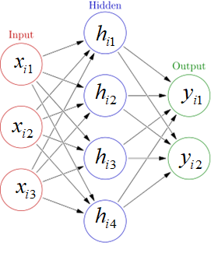
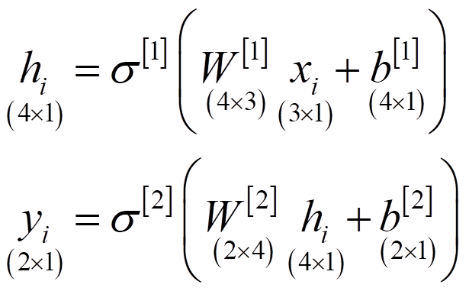
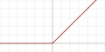
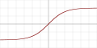
Neural networks (NN)
Can learn highly nonlinear multi-input/output relations
Highly flexible/nonlinear
Deep NN have many layers => representation learning
Less automatic to train than trees but can handle more complex data structures (e.g. Convolutional NN (CNN) for images or Recurrent NN (RNN) for time series/panel data)
Activation functions
Relu
Tanh
Notes:
http://neuralnetworksanddeeplearning.com/index.html
The idea is that h is a weighted average of all of the X‘s (plus a shifter), and y is a weighted average of the h‘s. All of the weights and shifters are parameters used to train the model. The machine learns as you feed it in labelled data based on a given penalty function (e.g. Sum of squared errors)

Slide 6
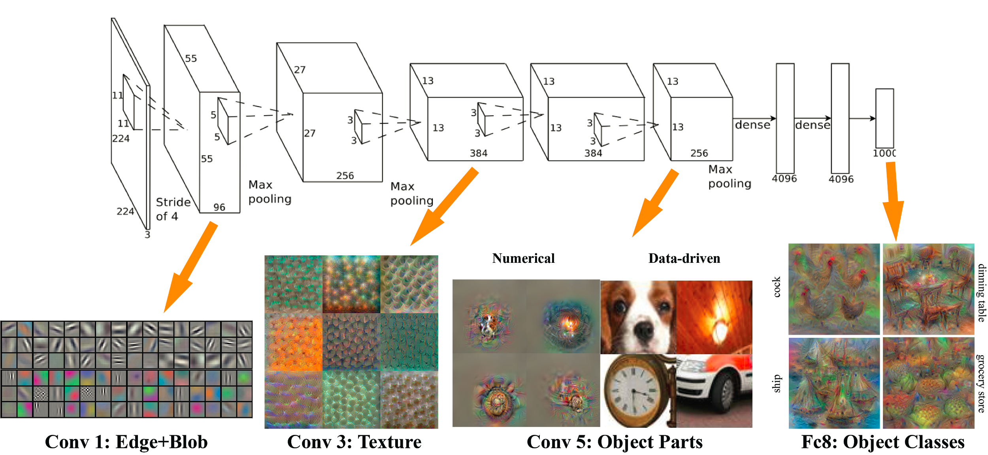
Representation learning - Illustration
Source:https://raw.githubusercontent.com/GKalliatakis/MatDeepRep/master/MatDeepRep%20Overview.png?raw=true

Slide 7
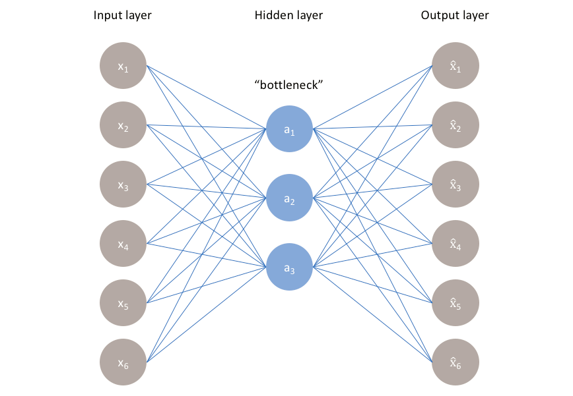
Unsupervised approaches
Autoencoder
Undercomplete autoencoder
Aim to learn joined probability of (x) instead of E(y|x)
Non-linear version of PCA
Aim: Extract most relevant features in (x)
Source: https://www.jeremyjordan.me/autoencoders/

Slide 8
How can NNs help?

Slide 9
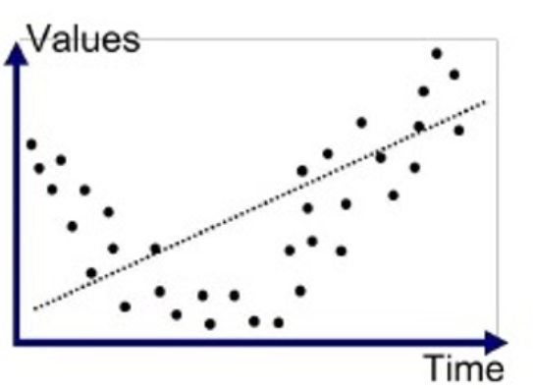
Restrictive functional forms
Many problems are non-linear. Theory provides only weak guidance
Particularly environmental/physical processes
Underfitting can lead to bias
Existing flexible econometric tools struggle with large K and/or N
NN good for time series (instead of AR)
Source:https://cdn-images-1.medium.com/max/1200/1*_7OPgojau8hkiPUiHoGK_w.png

Slide 10
Extract information from unstructured data
Unstructured data = everything that cannot be processed in a spreadsheet
Examples: (remote sensing) images, text, cell phone records, weather
Current approach: extract hand crafted features
ML approches
1) End-to-end learning
2) Unsupervised pre-training
3) Transfer learning
4) Automatic feature creation
5) Text methods

Slide 11
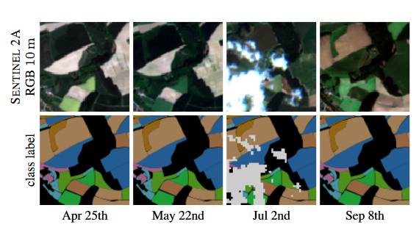
Unstructured data: End-to-end learning
Raw data as input variables (without preprocessing)
No manual feature extraction
No information loss
Requires large labeled datasets
Rußwurm and Körner (2017)
Crop classification with remote sensing
>137.000 labelled fields, 19 crops Bavaria, Germany (InVeKoS- Data)

Slide 12
Unstructured data: Unsupervised pre-training
First successful training of deep NN (Hinton et al. 2006)
Pretraining NN layers as autoencoder using unlabeled data
Train last layer using labeled data
Can make use of unlabeled data
Aims to preserve as much variation as possible (not necesssarily the most relevant variation)

Slide 13
Unstructured data: Transfer Learning
Use models trained in one context as starting point
E.g. “Representation learning”
Jean et al. (2016) poverty prediction: Transfer learning
VGG trained on ImageNet
Predict nightlights intensity classes from daylight images
Predict poverty indices
Why does it work? Examples, roofing material and distance to urban areas
Notes:
“Although nightlights display little variation at lower expenditure levels (Fig. 1, C to F), the survey data
indicate that other features visible in daytime satellite imagery, such as roofing material and distance to urban areas, vary roughly linearly with expenditure (fig. S2) and thus better capture variation among poorer clusters. Because both nightlights and these features show variation at higher income levels, training on nightlights can help the CNN learn to extract features like these that more capably capture variation across the entire consumption distribution (Jean, N., M. Burke, M. Xie, W.M. Davis, D.B. Lobell, and S. Ermon. 2016. Combining satellite imagery and machine learning to predict poverty. Science 353(6301):790–794, p. 791)”.
Using to predict food insecurity

Slide 14

Large number of explanatory variables
In many application K is large and/or high temporal/spatial resolution (scanner/climate date)
Current approach: Handcrafted collapsing, test driven selection, PCA, Bayesian model selection
ML approches
1) Can better handle large K
2) Unsupervised feature extraction
3) RNN/CNN to deal with high temporal/spatial resolution
Source:https://discuss.pytorch.org/t/example-of-many-to-one-lstm/1728
Notes:
one-to-one: Cross section
many-to-many: Panel

Slide 15
Causal inference and Identification
Causal inference can be thought of as a prediction problem: What would have happened in absence of the treatment?
(i) Counterfactual simulation [exogenous treatment]
(ii) Causal forests [selection on observables, heterogeneous effects]
(iii) Double Machine Learning [selection on observables, average effects]
(iv) ML Panel Methods [unobserved time-invariant characteristics]
(v) IV with may instruments [endogenous treatment, linear]
(vi) Deep IV estimation [endogenous treatment, nonlinear]

Slide 16
Counterfactual simulation
Problem: What if your counterfactual is highly non-linear and not easy to estimate? (say using means is going to miss a large part of the story)
E.g. Burlig et al. (2017)
Estimate the effect of an energy conservation program directed at schools
School energy demand – highly non-linear, large swings over time of day and day of week…
Predict counterfactual from controls and treatment observations before treatment came in
Works well with exogenous placement

Slide 17
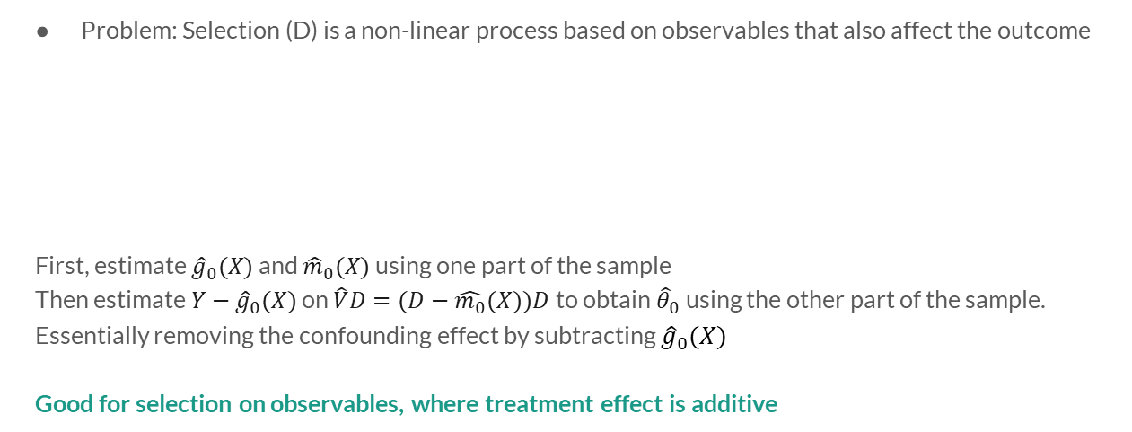
Double Machine Learning
Problem: Selection (D) is a non-linear process based on observables that also affect the outcome
First, estimate ${\hat{g}}_{0}(X)$ and ${\hat{m}}_{0}(X)$ using one part of the sample
Then estimate $Y−{\hat{g}}_{0}(X)$ on $\hat{V}D=(D−\hat{m_{0}}(X))D$ to obtain ${\hat{θ}}_{0}$using the other part of the sample.
Essentially removing the confounding effect by subtracting ${\hat{g}}_{0}(X)$
Good for selection on observables, where treatment effect is additive
Notes:
The idea behind DML is to offset the regularisation bias by orthogonalizing D in (1) with respect to X. In a first step, split the sample, train ${\hat{g}}_{0}(X)$ based on (1) and ${\hat{m}}_{0}(X)$ based on (2) using one part of the sample. This step is responsible for the name of the approach. In the second step, regress $Y−{\hat{g}}_{0}(X)$ on $\hat{V}D=(D−\hat{m_{0}}(X))D$ to obtain ${\hat{θ}}_{0}$from (1) using the main sample. Note that the approximate orthogonalization of D from X and the approximate removal of the confounding effect by subtracting ${\hat{g}}_{0}(X)$in the second step removes the regularisation bias.
Stripping out the X’s from D, and stripping out the g(X) from Y. V-hat x D is stripping out all of the parts of D that depend on X (i.e. it *is* the orthogonalization of D)
Example: Agricultural value = irrigation + other stuff, where other stuff is a function of geographic characteristics (X), and irrigation is also determined by geographic characteristics (X). Estimate the size of irrigation on geographic factors, and estimate ag value on geographic factors. Then strip out the effect of geographic factors from Ag value, leaving only the

Slide 18
Panel data
Problem: We may want to allow for non-zero fixed effects for all panel observations, while regularization would push (some of) them to zero
Lasso (and other methods) not set up to deal with correlation in error terms
Belloni et al. (2016) first strip out fixed effects, and then use regularization methods (e.g. Lasso) to estimate the rest, allowing for correlation in errors
Works well if you want a flexible functional form but still control for unobservables

Slide 19
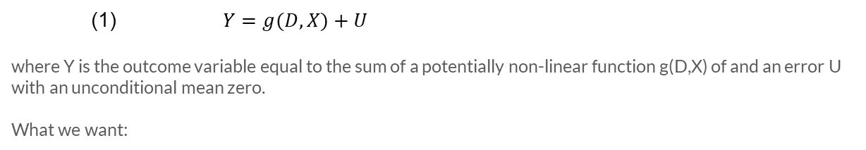
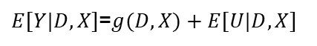
Deep IV
Problem: IV assumes linearity in first and second stages and homogeneity of treatment.
What we get:
(1) $Y=g(D,X)+U$
where Y is the outcome variable equal to the sum of a potentially non-linear function g(D,X) of and an error U with an unconditional mean zero.
What we want:
(2) $h(D,X)=g(D,X)+E[U|X]$,
$E[Y|D,X]$=$g(D,X)+E[U|D,X]$

Slide 20
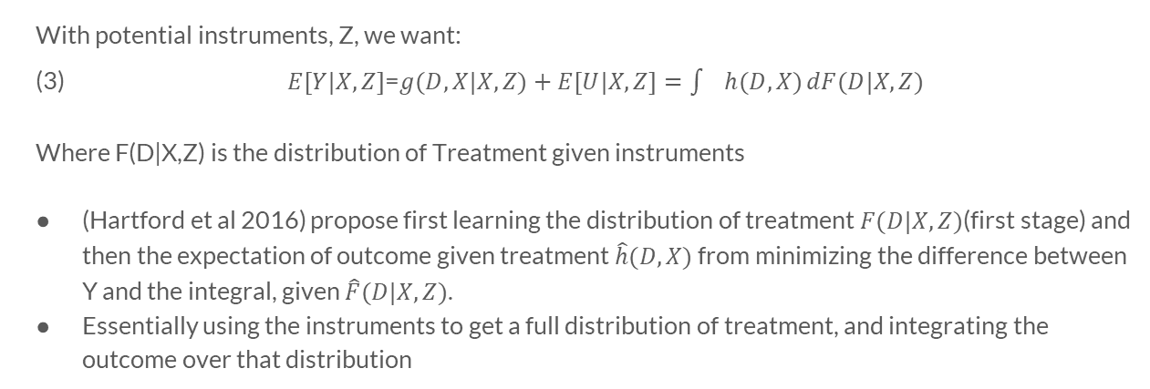
Deep IV cont’d
With potential instruments, Z, we want:
(3) $E[Y|X,Z]$=$g(D,X|X,Z)+E[U|X,Z]=\int{h(D,X)}dF(D|X,Z)$
Where F(D|X,Z) is the distribution of Treatment given instruments
(Hartford et al 2016) propose first learning the distribution of treatment$F(D|X,Z)$(first stage) and then the expectation of outcome given treatment $\hat{h}(D,X)$ from minimizing the difference between Y and the integral, given $\hat{F}(D|X,Z)$.
Essentially using the instruments to get a full distribution of treatment, and integrating the outcome over that distribution

Slide 21
Example: RNN to evaluate farm policy
How does farm policy affect farm structure?
Why do we care?
Much agricultural policy is justified by the ‘need to preserve the family farm’
Most agricultural policies have differentiated payments based on size and/or payment caps
Challenges:
(1) multi-dimensional measure of farm structure
(2) non-linear policy (and policy effects) – over multiple outputs
(3) spatial dependence
(4) dynamics
Notes:
Two farms with the same revenue might have very different ‘structures’

Slide 22
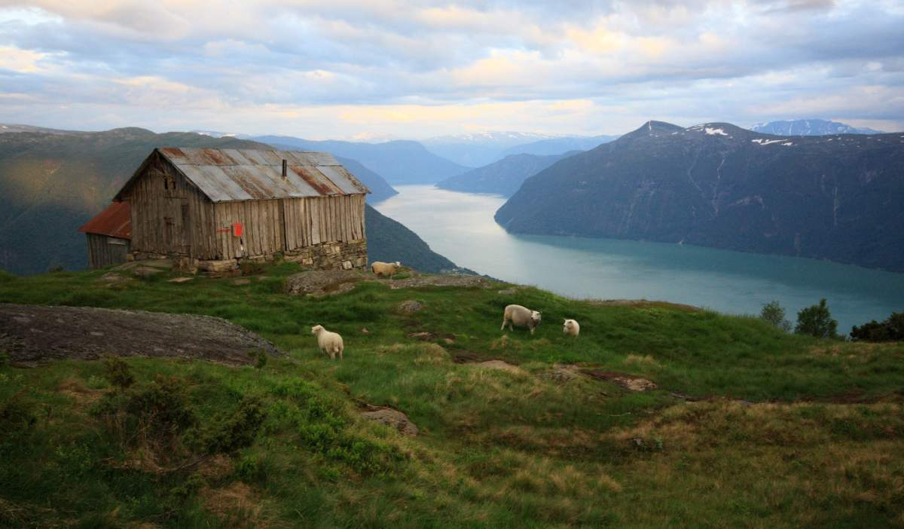
Why Norway?
Very detailed data (>70,000 geocoded farms from 1999-present)
Very complex, activist farm policy, with many kinks
Regional heterogeneity
Policy notes
Subsidy levels updated each year in negotiation with the farmer’s union
Paid based on last year’s activity level
Producer Support Estimate
Country | 2017
Iceland | 55.72
Korea | 53.55
Norway | 52.99
EU | 18.32
OECD - Total | 17.82
United States | 9.88

Slide 23
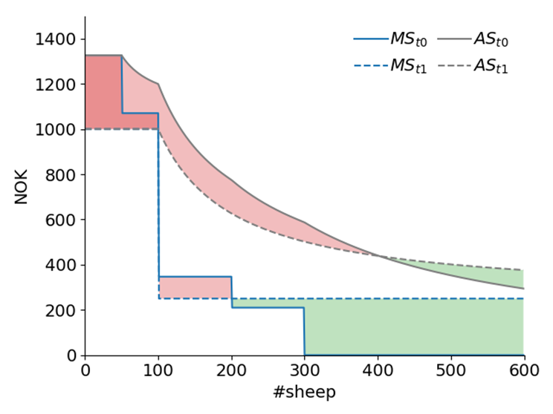
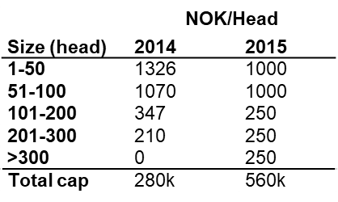
Policy change

Slide 24
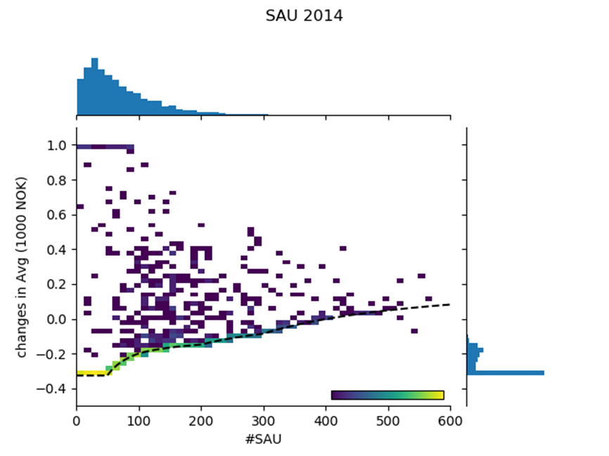
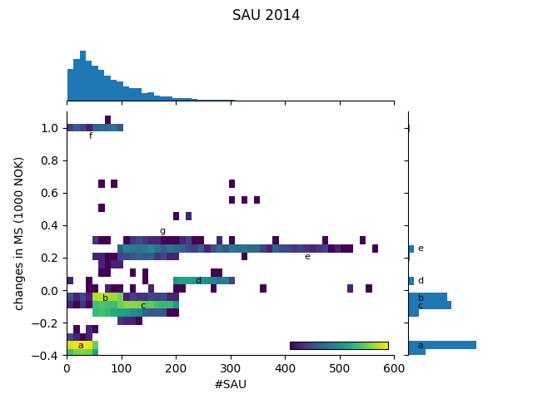
Raw data
Marginal Subsidy
Average Subsidy
# sheep 2014
# sheep 2014
Notes:
For example cluster a for farms in figure 2 correspond to farms with <50 sheep for which rates are reduced from 1326 to 1000 (resulting in a change in marginal subsidy equal to 326). Cluster b correspond to farms with 50<sheep<100 sheep where rates are reduced from 1070 to 1000. Cluster c correspond to farms with 100<sheep<200 sheep where rates are reduced from 347 to 250. The changes in marginal subsidies for clusters a, b and c are represented by the red areas between the blue lines in figure 1. Cluster d corresponds to farms with between 200 and 300 sheep, where rates where increase from 210 to 250 and cluster e correspond to farm with more than 300 sheep, where rates where increase from 0 to 250.

Slide 25
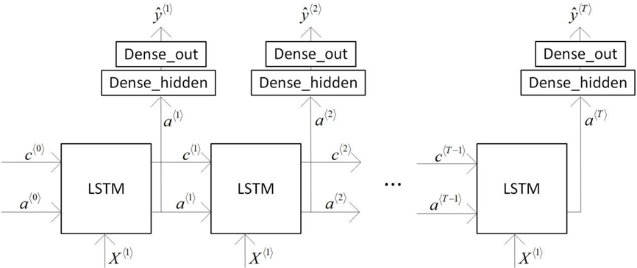
Recurrent NN with Long Short Term Memory (RNN-LSTM)
LSTM cells pass information across time in a cell-state vector c
Takes new input each period (X) and use gates to figure out what information it can keep and what we can forget (a = Gc)
Notes:
The crucial feature of an RNN is that past information is carried across time using a cell state vector. This cell state vector as well as the new incoming information from the explanatory variables in each time step is processed in the LSTM cells using different gates. Intuitively, these gates, determine which past and new information is forgotten or maintained. A crucial feature is that the model learns by itself in which way forgetting and maintaining this information should take place.

Slide 26
Intuition
Cell state encodes past information
Model learns itself how to encode information
and which information to keep/forget
no need to specify lag structure
Lag structure can vary across variables
Example:
Farm stops milk production
Specific number of cows every past year might not be relevant
Sufficient to encode that it had dairy once (maybe the maximum number of cows)

Slide 27
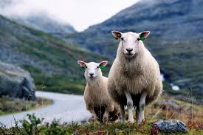
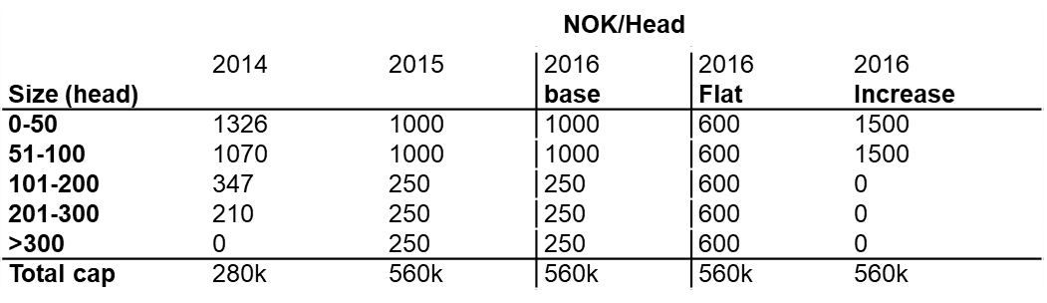
Simulation

Slide 28
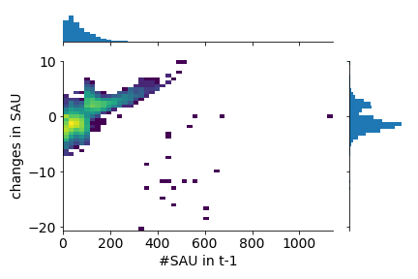
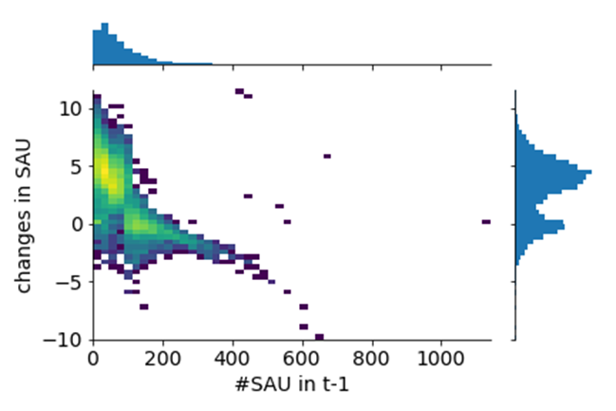
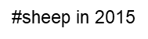
Changes in sheep
Flat
Increase
changes in #sheep
changes in #sheep
#sheep in 2015

Slide 29
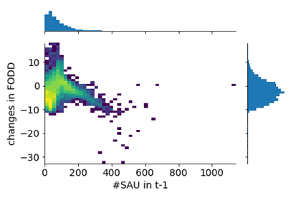
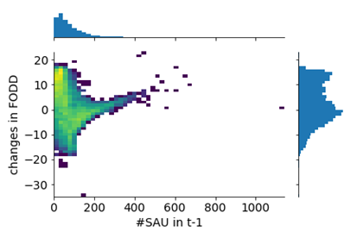
Fodder
Flat
Increase
#sheep in 2015
#sheep in 2015

Slide 30
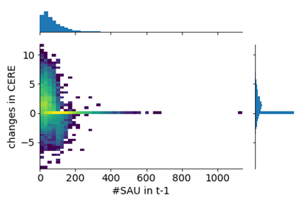
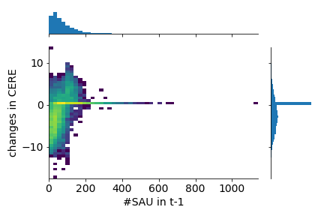
Cereals
Flat
Increase
#sheep in 2015
#sheep in 2015

Slide 31
Implications
Without explicit economic information, RNN is able to pick up reasonably direct and indirect responses to changes in subsidies
Able to model more complex dynamic processes than standard AR models
And more complex spatial patterns

Slide 32
Lots of things yet to do…
Explore dynamics
Embed farm fixed effects
Compare to standard panel model estimation
Explore how well CNNs can pick up spatial dependence

Slide 33
ML and Environmental Econ: Coming soon
Thinking hard about selection of input data
Introducing structure into ML models
Statistical properties of ML and uncertainty (probabilistic programming)
Application to Causal Inference

